Slide 1
Presentation Group 1
Presented by Marco, Pablo, Lukas and Thirith

Slide 2
Summary
1) Data structure - Lukas
2) Learning to make bread - Pablo
3) To good to go - Thirith
4) Additional Feature – Sleeping Baker - Marco
5) Quick demonstration

Slide 3
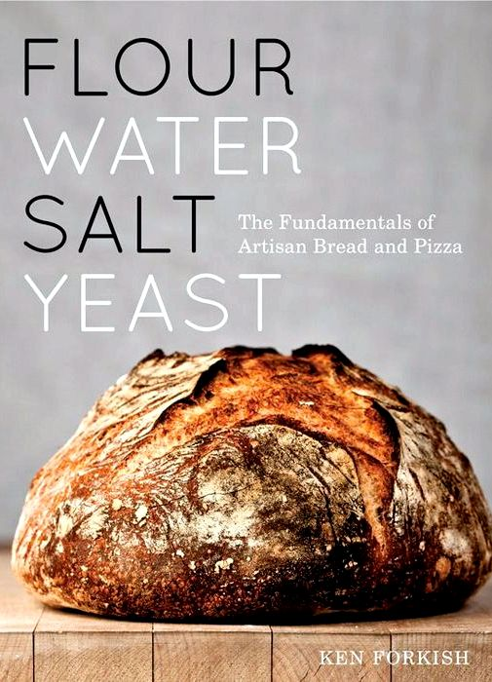
1) Data Structure (for learning to make bread)
Recipe Book
Binary Tree
With char* array
→ containing ingredient names
Inventory
Binary Tree
With additional third branch
containing units of ingredients
→ Both very similar!

Slide 4

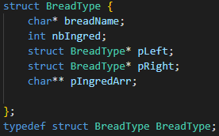
Recipe Book
Lexicographically sorted
Struct BreadType
Which values does it hold?
ad
Important functions:
int registerBreadType();
char** getIngredArray();
asd
adsad
Figure 1: Basic representation of Recipe Book
Figure 2: BreadType struct

Slide 5
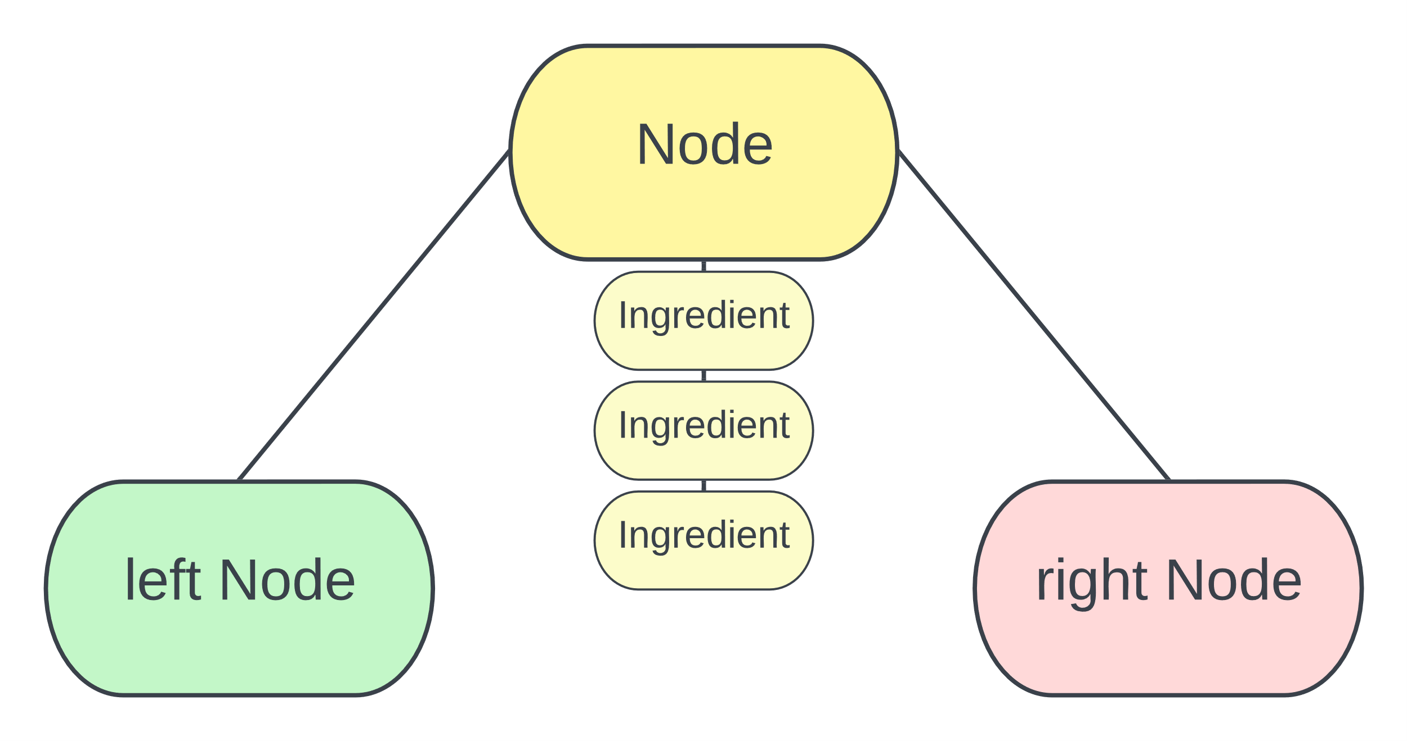
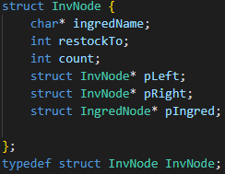

Inventory
Lexicographically sorted
Struct InvNode
Which values does it hold?
Struct IngredNode
Important functions:
void registerIngredient();
void addIngredient();
int takeIngredient();
void restockIngredients();
Figure 3: Basic representation of Inventory
Figure 4: InvNode struct
Figure 5: IngredNode struct

Slide 6
Inventory
Advantages
Generally: fast search
Very adaptable
Disadvantages
Can be complex
Hard to delete tree nodes (which we do not do)
Wort case: linked list like performance

Slide 7
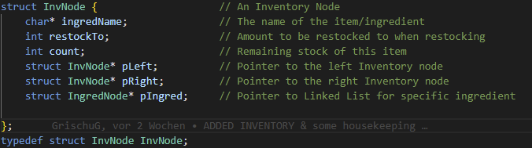
Data Structure (for learning to make bread)
Binary Tree
One node (InvNode) per ingredient type:
Name of the ingredient
Initial and remaining stock
Holding a linked-list, every node of that list represents one unit of that ingredient
Tree is lexographically sorted -> efficient searching in inventory for ingredient

Slide 8
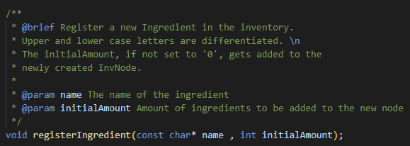
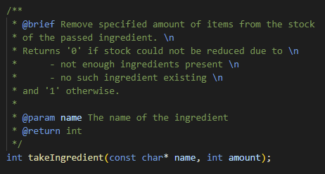
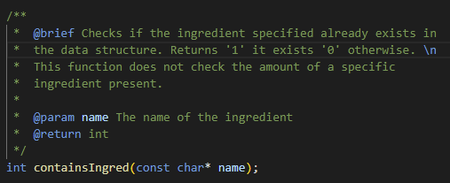
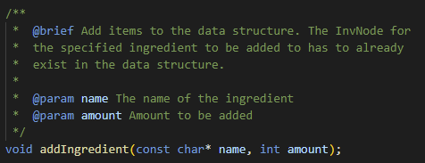
Inventory
Methods to register and access ingredients by their name:

Slide 9
2) Learning to Make Bread
Add one
Add two

Slide 10
Template
Add one
Add two

Slide 11
Template
Add one
Add two

Slide 12
Template
Add one
Add two

Slide 13
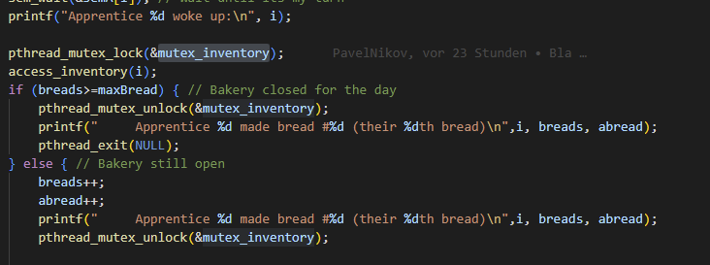
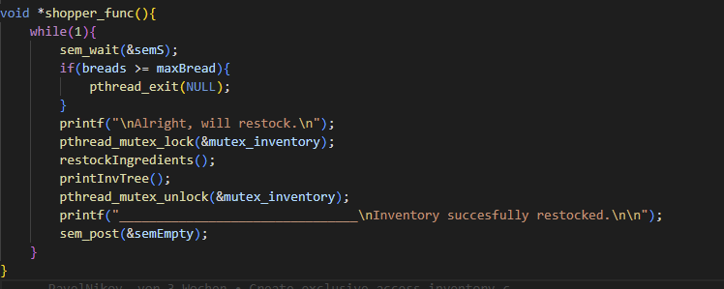
Making Bread
Access to the inventory is protected: Only one client can access the inventory at the same time:
Shopper accessing and apprentice the inventory:

Slide 14


Making Bread
Semaphore for coordination between apprentices, baker and shopper:
Apprentice waits for his turn:
Baker wakes an apprentice:

Slide 15
3) Too Good To Go
Main thread is baking bread and selling those bread afterwards
When selling bread:
Decide if we want to donate bread as too good to go
Don’t donate on every bread sold
After selling, evaluate a flag if its time for a donation
If flag is set, donate bread as too good to go and reset the flag
Run a second thread (the “coordinator”) which will set the too good to go-flag

Slide 16
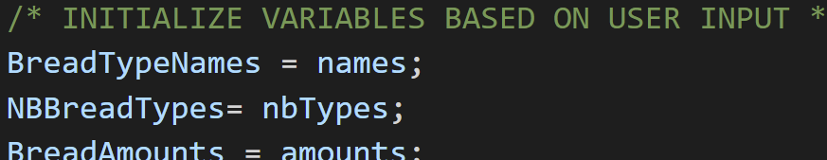
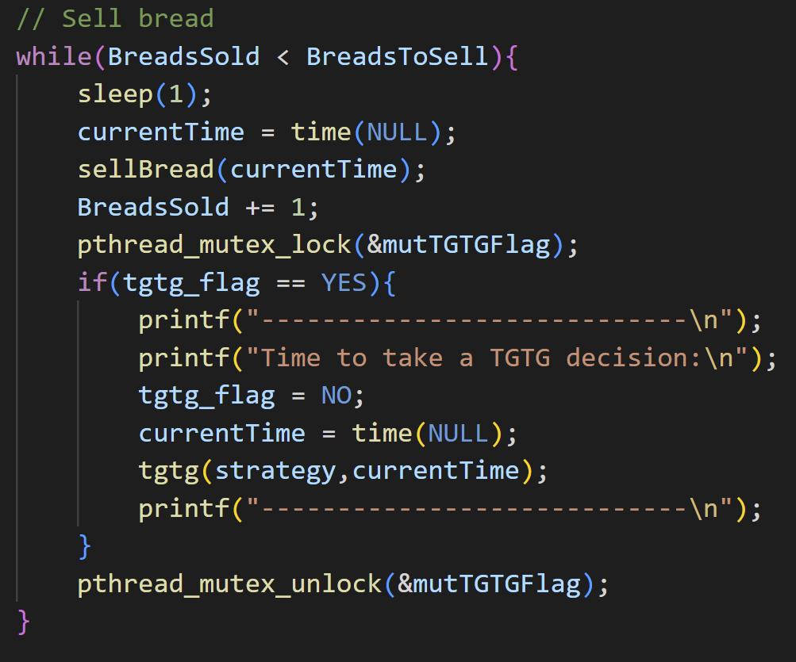
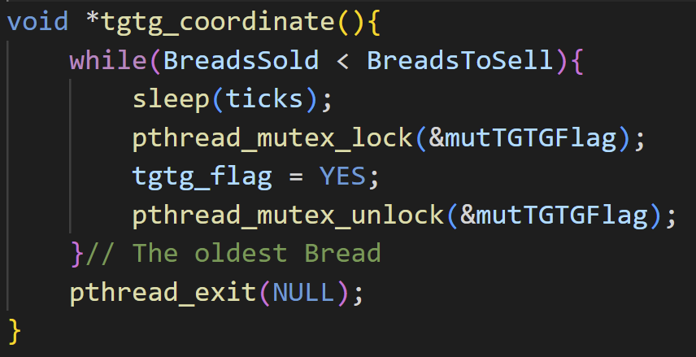
Too good to go: Main thread and coordinator
Main thread:
Initialize the data structures
Create a mutex to protect the too-good-to-go flag
Start the coordinator-thread
Bake requested amount of bread
Sell bread and make too-good-to-go decisions
Coordinator: Simply set the flag:

Slide 17
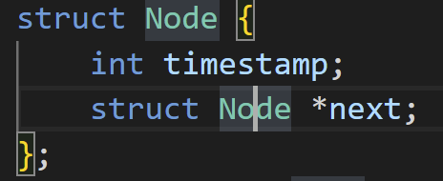
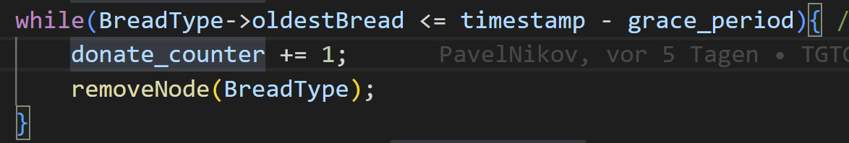
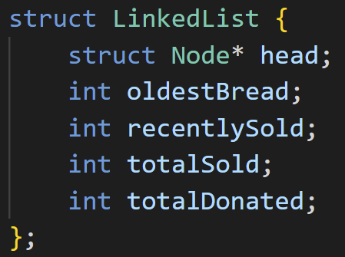
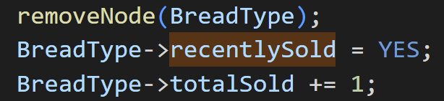
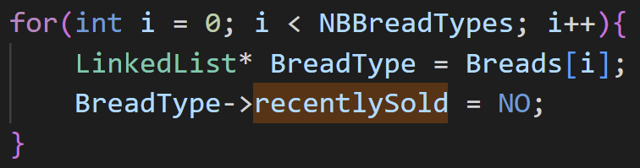
Too good to go: Different strategies
Donate old bread: First in, first out
Every bread baked, is stored together with its bakery timestamp
The inventory stores the timestamp of the oldest bread for every bread-type
On donate, evaluate current time (minus some grace-period) and oldest-bread-time: Donate all “old” bread
Second chance:
Similar, but we remember in the inventory if a bread-type was sold recently. If not, we donate old bread of that type.

Slide 18
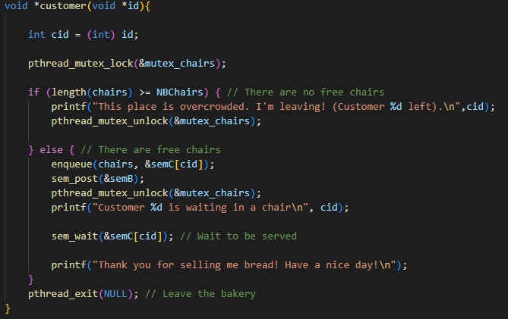
4) Additional Feature – Sleeping Baker
Timing
Add two

Slide 19
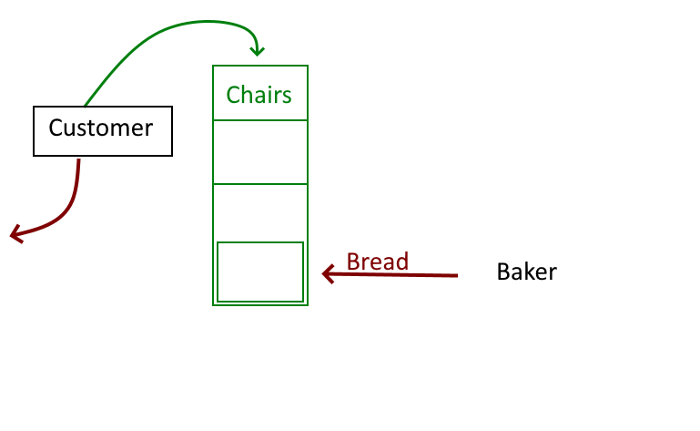
Template
Add one
Add two

Slide 20
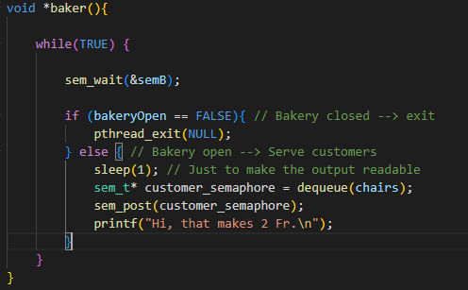
4) Additional Feature – Sleeping Baker
Add one
Add two

Slide 21
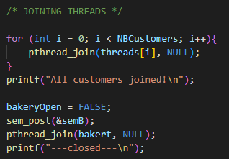
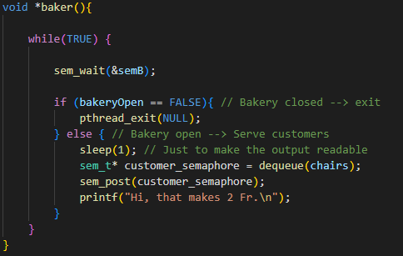
Template
Stopping Condition:

Slide 22
5) Demonstration
Add one
Add two

Slide 23
Template
Add one
Add two

Slide 24
Template
Add one
Add two

Slide 25
Thank you for your attention!
Any Questions?

Slide 26
Sources:
Flour Water Salt Yeast: http://bestcookideas.com/uploads/images/best-artisan-bread-recipe-book_1.jpg

